Slide 1


Phishing Awareness Training
By Shaikh Mohd Ayaan Iqbal

Slide 2
Topics Covered :-
Phishing
Forms and Signs of Phishing
Recognizing Phishing Attacks
Social Engineering Tactics used by Phishing Attackers
Best Practices and Tips to avoid falling Victim
Real-world Examples and Interactive Quizzes

Slide 3
Phishing
Phishing is a type of cyberattack where attackers pose as trusted organizations or individuals to deceive people
into sharing confidential
information such as passwords,
credit card numbers, or
personal details.
This is usually done through
fake emails, websites, messages,
or phone calls that look convincing
and create a sense of urgency to
trick the victim into responding
quickly.

Slide 4
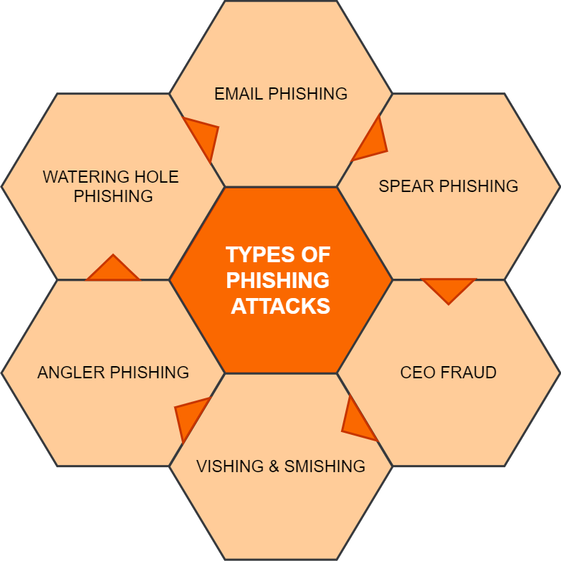
Forms of Phishing
Phishing comes in several forms, including email phishing, smishing (SMS phishing), vishing (voice call scams),
spear phishing (targeted attacks
using personal information),
and clone phishing (replicating
a legitimate email with malicious
changes). Attackers may also
create fake websites that look identical
to real login pages to steal credentials.
These different methods all aim to trick
users into clicking malicious links,
downloading harmful attachments, or
providing sensitive information.

Slide 5
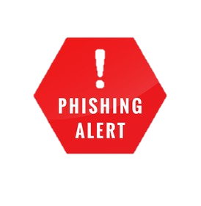
Signs of Phishing
Common signs of phishing include unexpected messages requesting personal details, urgent or threatening language (“Your account will be blocked!”), suspicious links or attachments, mismatched or slightly altered
email addresses, poor grammar
and spelling errors, and generic
greetings like “Dear Customer.”
Fake websites may have unusual
URLs, missing security certificates,
or design inconsistencies.
Recognizing these red flags helps
individuals avoid falling victim to phishing attempts.

Slide 6
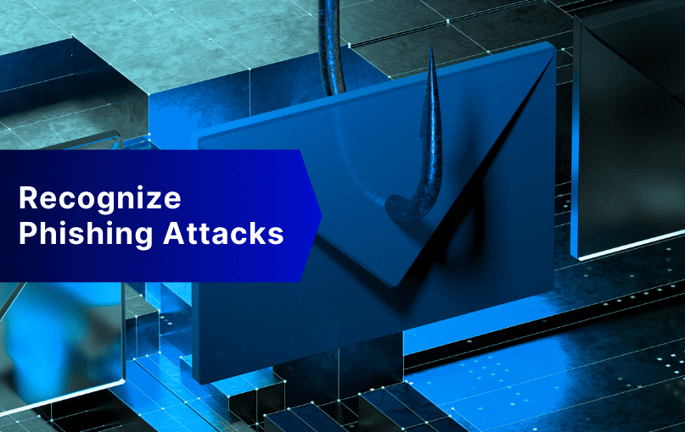
Recognizing Phishing Attacks
Recognizing phishing attacks involves paying close attention to signs that a message, email, or website may be fake or malicious.
One of the biggest indicators is unexpected communication that
asks for personal information,
login credentials, or financial
details. Phishing messages
often create urgency—claiming
your account will be locked, your
payment failed, or you must act
“immediately.” These tactics are
designed to pressure you into
responding quickly without
verifying the source.

Slide 7
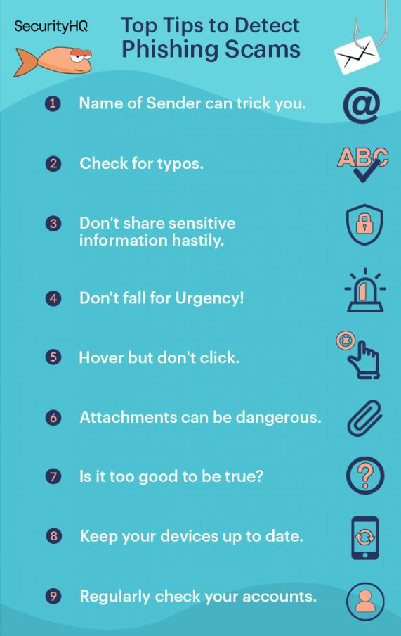
You can also spot phishing attempts by examining details closely. Check the sender’s email address for small misspellings or unusual domains. Hover over links (without clicking) to see if the URL matches the legitimate website. Look for poor grammar, spelling mistakes, or generic greetings like “Dear Customer.” Be wary of unexpected attachments, especially ZIP, EXE, or PDF files from unknown senders. On websites, verify the URL, check for HTTPS, and watch for unusual layouts or login pages. By staying alert and double-checking suspicious details, you can effectively recognize and avoid phishing attacks.

Slide 8
Social Engineering Tactics used by Phishing Attackers
Phishing attackers rely heavily on social engineering tactics to manipulate people into revealing sensitive information or performing harmful actions. One common tactic is pretexting, where attackers create a believable story or scenario—such as posing as bank officials, company IT staff, or government agents—to gain the victim’s trust. Another method is baiting, where victims are lured with promises of rewards, free downloads, or special offers that actually contain malware or malicious links. Attackers also use urgency and fear, sending messages that claim accounts will be suspended or payments have failed, pressuring victims to act without thinking.

Slide 9
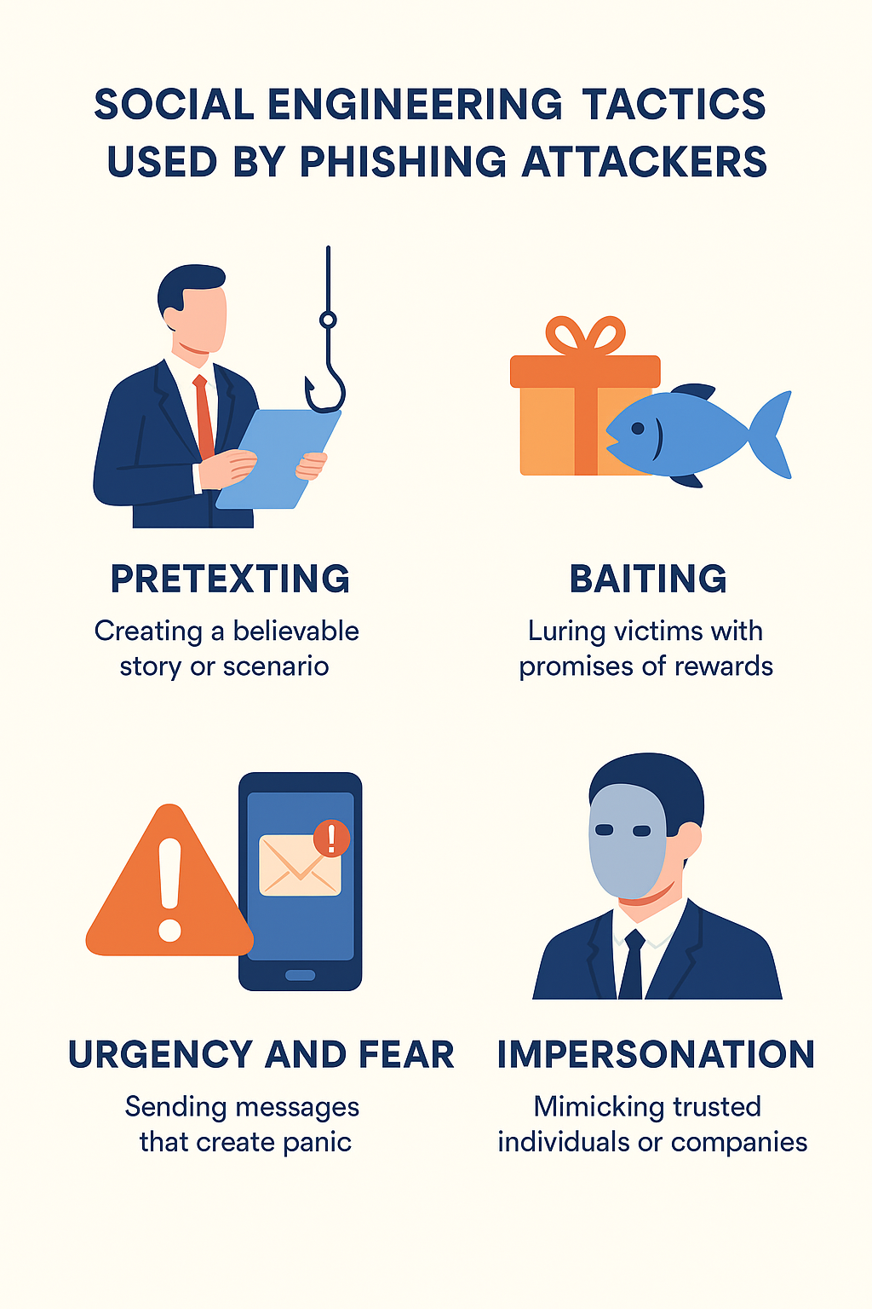
Impersonation is another widely used tactic, where attackers mimic trusted individuals, colleagues, managers, or well-known companies to appear legitimate. In spear phishing, attackers collect personal information from social media to craft highly personalized messages that seem authentic. Clone phishing involves copying a previously received real email and replacing links or attachments with malicious versions. These tactics exploit human emotions—trust, curiosity, fear, and helpfulness—making social engineering one of the most powerful tools in phishing attacks.

Slide 10
Best Practices and Tips to avoid falling Victim
One of the most effective ways to avoid phishing attacks is to stay cautious and verify everything before taking any action. Always double-check the sender’s email address, especially if the message asks for sensitive information or urges you to act quickly. Hover over links to preview the actual URL before clicking, and avoid downloading attachments from unknown or unexpected sources. Use strong, unique passwords for different accounts and enable Multi-Factor Authentication (MFA) to add an extra layer of protection. Keeping your software, browser, and antivirus updated also helps block many phishing attempts automatically.

Slide 11
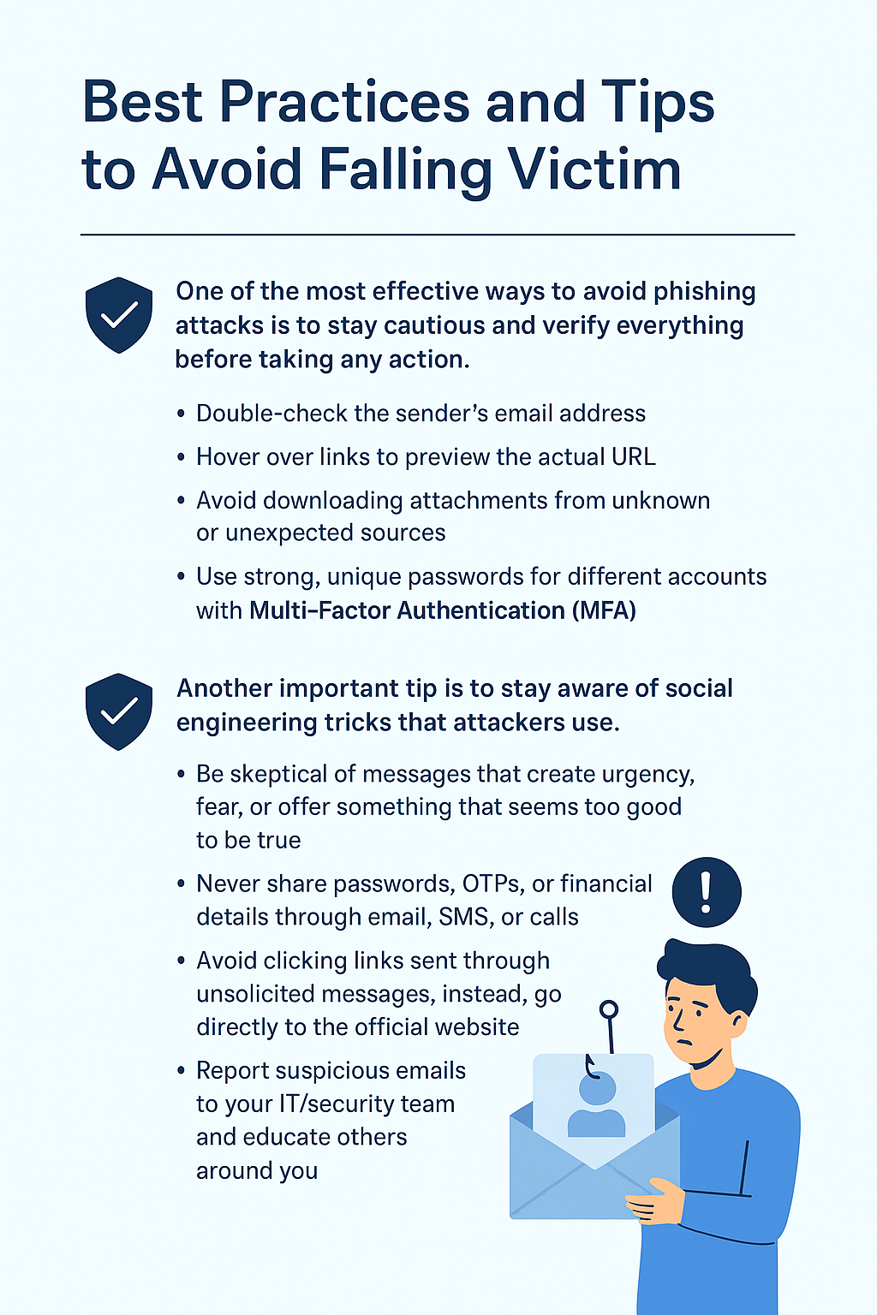
Another important tip is to stay aware of social engineering tricks that attackers use. Be skeptical of messages that create urgency, fear, or offer something that seems too good to be true. Never share passwords, OTPs, or financial details through email, SMS, or calls—no legitimate organization will ask for them. Avoid clicking links sent through unsolicited messages; instead, visit the official website directly by typing the URL yourself. Finally, report suspicious emails to your IT/security team and educate others around you to build a safer online environment.

Slide 12
Real-world Examples
1.} The Fake Bank Verification Scam :
A widely reported phishing incident involved attackers sending emails that appeared to come from a well-known bank. The email claimed that “unusual activity” had been detected in the customer’s account and that immediate verification was required to avoid suspension. The message included an urgent tone, an official-looking logo, and a link that seemed genuine at first glance. When victims clicked the link, they were taken to a fake website that perfectly mimicked the bank’s login page. Once they entered their username, password, and OTP, the attackers captured the information in real time and used it to access the victims’ actual bank accounts. Many people lost money within minutes because the attackers initiated transactions using the stolen credentials.

Slide 13
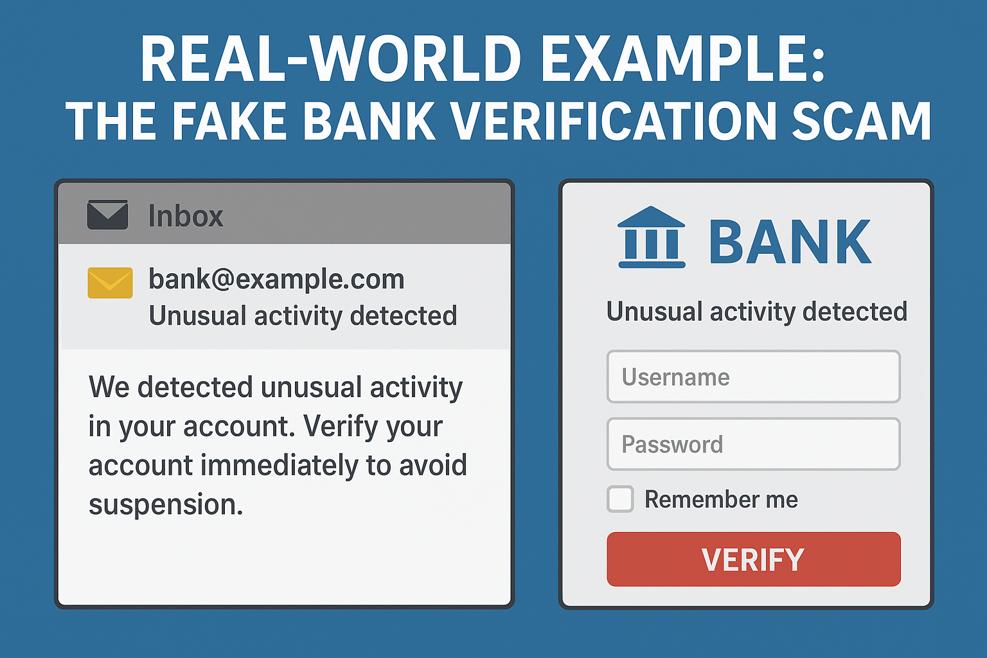

Slide 14
2.} The Fake Delivery Notification Scam :
Many people receive phishing messages pretending to be from popular courier services like FedEx, DHL, BlueDart, or Delhivery. The message usually states that a package could not be delivered due to “unpaid fees,” “incorrect address,” or “verification required.” It includes a link that looks legitimate but actually leads to a fake tracking page. Once users click, they are asked to enter their personal details, card information, or pay a small “delivery fee.”
Victims who enter their information often find that their bank accounts are charged with large unauthorized transactions. In some cases, clicking the link installs malware on the phone, allowing attackers to steal OTPs or access sensitive data. This scam works because people frequently order online, making the message appear believable.

Slide 15
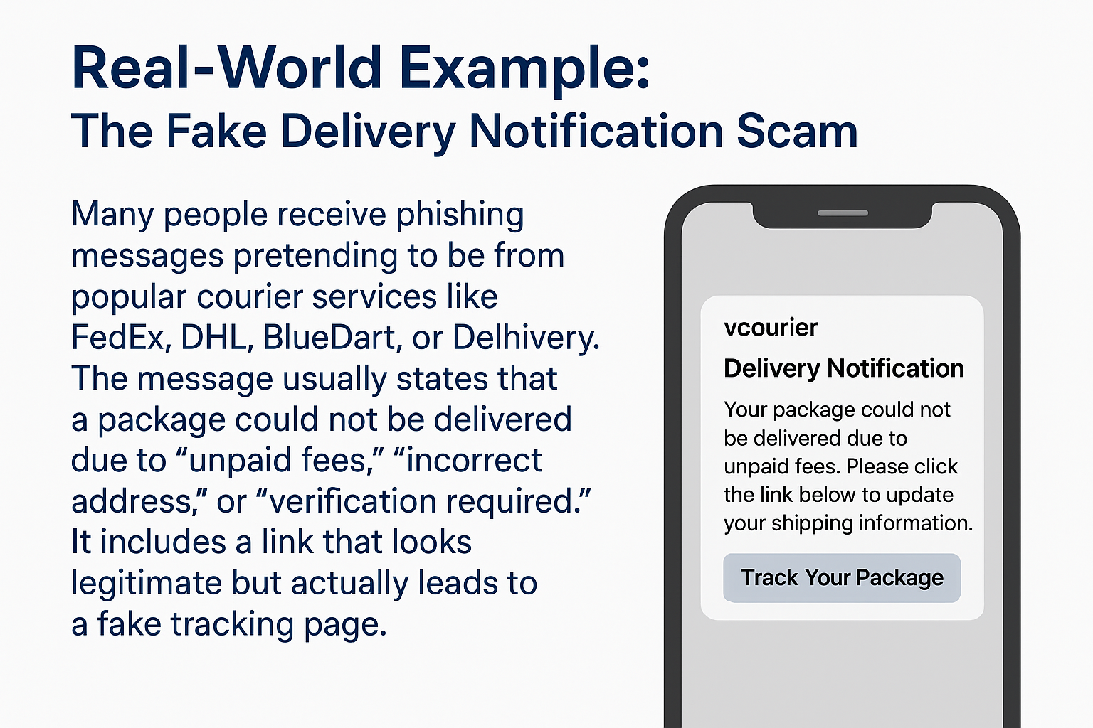

Slide 16
3.} CEO Fraud / Business Email Compromise (BEC) :
In this attack, cybercriminals impersonate a company’s CEO or senior executive by spoofing their email address. They typically send a message to an employee in the finance or accounts department, urgently requesting a confidential money transfer, invoice payment, or gift card purchase. The email often includes phrases like “I’m in a meeting,” “This is highly confidential,” or “I need this done immediately,” which pressures the employee into complying without verification.
Several companies worldwide have lost millions of dollars to this scam. One notable case involved a large European firm where an attacker posed as the CEO and convinced an employee to transfer more than €40 million to fraudulent accounts. Because the message looked legitimate and used internal communication style, the employee followed the instructions, resulting in a massive financial loss.

Slide 17
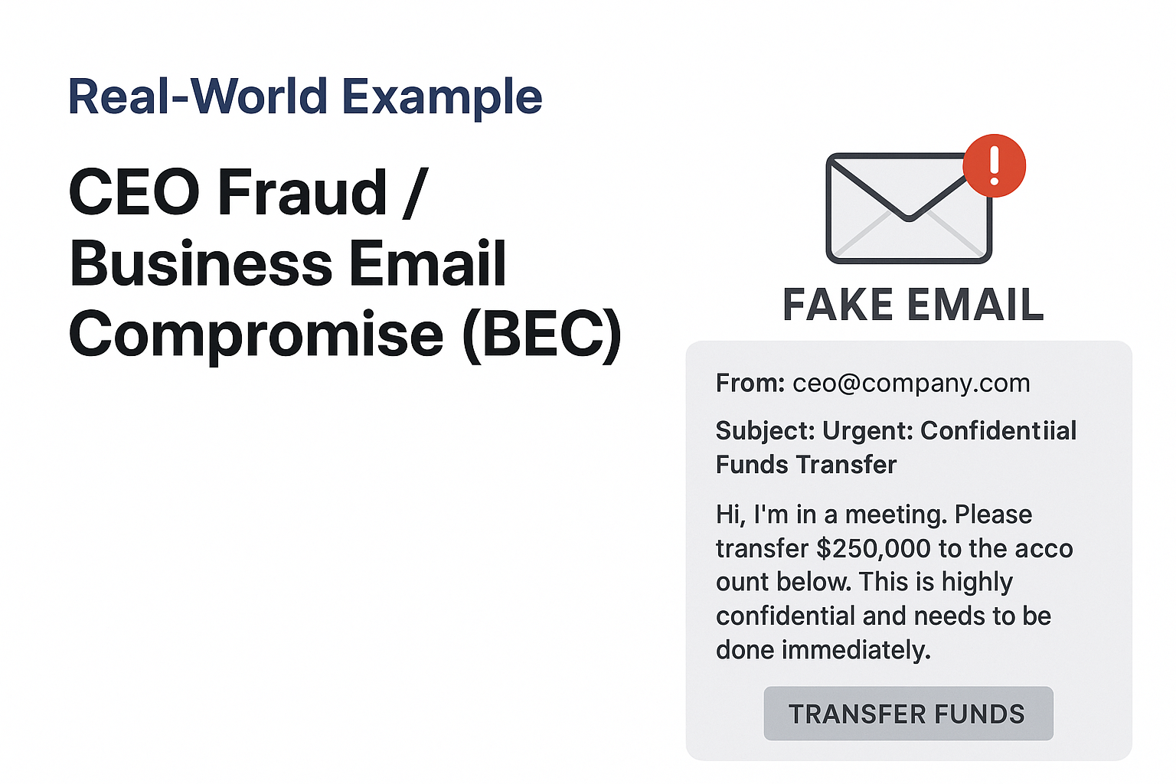

Slide 18
Interactive Quizzes Related to Above :
MCQ
True or False

Slide 19
MCQ
What is the primary goal of a phishing attack?
To improve internet speed
To steal sensitive information from victims
To fix computer errors
To update your software
Correct Answer: B

Slide 20
2. Which of the following is a common sign of a phishing email?
Personalized greeting
Correct spelling and grammar
Unexpected urgent request asking you to click a link
Email from someone you know but with correct details
Correct Answer: C

Slide 21
3. What social engineering tactic uses urgency to force quick decisions?
Reverse engineering
Scarcity and pressure tactics
Data encryption
Technical analysis
Correct Answer: B

Slide 22
4. What should you do before clicking any link in an email?
Click quickly before the link expires
Hover over the link to preview the actual URL
Download attachments first
Forward to everyone for verification
Correct Answer: B

Slide 23
5. Which of the following is a best practice to avoid phishing scams?
Using the same password everywhere
Sharing OTPs with trusted people
Enabling Multi-Factor Authentication (MFA)
Ignoring software updates
Correct Answer: C

Slide 24
True or False
Phishing attacks often use urgency to trick victims into acting quickly.
- True
2. Legitimate companies frequently ask for passwords or OTPs through email.
- False
3. Hovering over a link without clicking can help you check if it is safe.
- True

Slide 25
4. Poor grammar and spelling errors can be signs of a phishing email.
- True
5. Using the same password for multiple accounts increases safety.
- False
6. Multi-Factor Authentication (MFA) helps protect you from phishing attacks.
- True
7. Fake websites always look unprofessional and easy to detect.
- False

Slide 26
The End

